Slide 1
Unit 0 School Task

Slide 2
The Unit 0 task
Slide 9.1
Unit 0 questions
Two Unit 0 questions to be attempted by Year 5 -Year 8 classes
Following completion of questions individually (without any prompts in advance from the teacher) pupils work in pairs explaining their approaches and thinking.
Analysis of pupil thinking
Evidence of pupil thinking collected by teacher (diagrams annotation, posters, or even audio) for discussion at Workshop 1.
Planning considerations
Which resources (plain or square paper ?)
Which class(es) ?
What evidence you might collect to share ?
Challenges, issues and barriers and how they might be overcome

Slide 3
MR Question 1
Slide 5.2

Slide 4
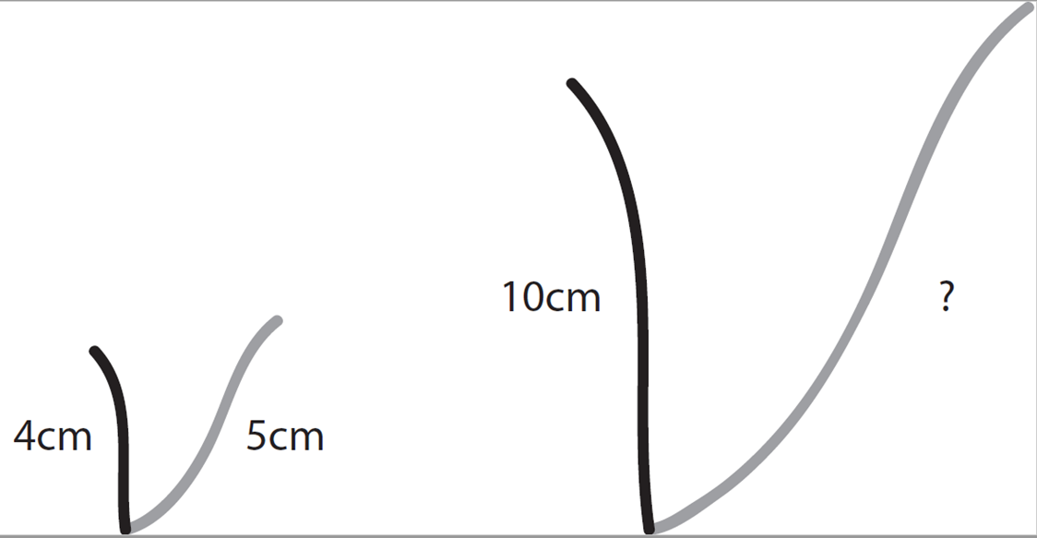
MR Question 2a
Slide 5.3
These two letters are the same shape, but one is larger than the other.
How long is the grey curve labelled with ?
4cm
5cm
A
10cm
B

